Slide 1
Wound Care Collaborative Community
Business Meeting – May 5 2021

Slide 2
Agenda
Steering Committee, structure and development- will establish the coordination of structure via meeting in next 30-45 days
Meetings and Communication to WC Community-looking for opportunities
3 Work Groups Chairs and steps to develop-
Tools: Recommend milestones, goals and start with platform that WEP-CEF developed- COSs discussion- evidence and methods Dr. Lisa Gould
RWD: Start the discussion- Marcia Nusgart and Dr. Robert Snyder
GAPS: Dr. William Li
Recommendation for additions to WCCC

Slide 3
May 2021 update:
Steering Committee nominated and selected
Fund raising efforts in force
Legal Council Weinberg Law PLLC - Non-profit 501 (c) (3) status - approved - EIN number for IRS tax determination –submitted
Website www.woundcarecc.org
Contact info: info@woundcarecc.org 312 201-6771

Slide 4
2021 WCCC Steering Committee
Oscar Alvarez, PhD (research)
Geoffrey Gurtner, MD (Assoc)
Gary Gibbons, MD (clinician)
William Li, MD (foundation)
Joseph Rolley, MS (Industry)
Randy Schwartz, BA (Strategy)
Brendan Casey, PhD (Industry)
Marjana Tomic-Canic, PhD (research)
Marcia Nusgart, RPh (Assoc)
K. Dev Verma, MD (FDA)
Ruth Bryant, PhD, RN (Assoc)
Charles Andersen MD (clinician)
Marissa J Carter PhD (Research)
Rob Snyder, DPM (Academia)
Bill Padula, PhD (Research)

Slide 5
SC Structure –Work in Progress
Will provide strategic oversite with very broad representation and impact.
Assist WCCC work groups in accomplishing their goals
Monitor progress of work groups
Assist the WCCC officers to set the agenda for WCCC business meetings.
Will have overview of the budget as presented by the WCCC Treasurer
The SC will be chaired by the WCCC Chairperson

Slide 6
Forums and Communicating the Message 2021
Advanced Wound Care Conference (AWCC), May
Wound Management & Prevention News Update, June or July
American College of Wound Healing and Tissue Repair (ACWHTR) meeting, July
SC meeting at SAWC fall (virtual or in-person), Oct
Innovations in Wound Care (IWH), Dec

Slide 7
Work Groups
Have done some preliminary work goals of work groups
Will invite chairs of groups and members
Tools- Recommend milestones, goals and start with platform that WEP-CEF developed. COSs discussion- evidence and methods Dr. Lisa Gould
RWD- Start the discussion - Marcia Nusgart and Dr. Robert Snyder
GAPS- Dr. William Li, remarks from a forward thinker
Notes:
Identify the clinical validated methods and tools (current and future) that have sufficient evidence to measure wound care clinical and patient-centered endpoints, especially those demonstrated as priorities for patients and providers through the WEF-CEP research and accepted as primary endpoints in wound care by the FDA. Publish findings as a way to help educate the wound care community.
Gain agreement on preferred validated tools for utilization in clinical trials with government agencies and payers.
Identify gaps in methods or validation in clinical outcome tools.
Develop an understanding and discuss regulations that would embody sufficient flexibility to accommodate the emerging tools and methods in the wound care field.
Discuss the growing access to diverse 'real-world' data sources and its role in enabling new approaches to close persistent evidence gaps. Create a collaborative document that articulates general acceptance of key standards that constitute robust clinical and scientific evidence to be used in clinical trials and top-level publications.

Slide 8
WCCC Tools Work Group
Suggested process
Develop list of tools currently being used to measure wound care outcomes
Expand upon the WEF-CEP list of tools
Determine how the tools have been validated
Published literature
Grey literature
Consider survey of wound care community with large list of validated tools to determine actual use in research vs clinical practice
Publish findings
Consider a list of tools that are in the pipeline
Match validated tools to Endpoints to develop a Core Outcome Set
Publish Wound Care Core Outcome Set
Match pipeline tools to Endpoints for future updates to the Core Outcome Set

Slide 9
WCCC Tools Work Group
Opportunity to develop a Core Outcome Set (COS) for Wound Care
Major challenge in all of medicine, not just wound care
Definition: ‘An agreed upon standardized set of outcomes that should be measured and reported, as a minimum, in all clinical research in specific areas of health or health care.’ *
Includes the outcome domains and the corresponding measurement tools or instruments
Value of a COS
Minimizes outcome reporting bias
Enhances clinical interpretability
Allows pooling of results across clinical trials
Consistent across the life cycle of a product from market approval to market access to actual use
https://nationalhealthcouncil.org/coa-series-core-outcome-sets
* COMET initiative

Slide 10
Core Outcome Domains
Survival/Mortality
Physiological/Clinical/Biomarkers
Symptoms
Function
Resource Use

Slide 11
WEF-CEP Identified Core Outcome Domains
15 Evidence-based Endpoints
Time to heal (FDA accepted primary endpoint)
Percent area reduction (FDA accepted secondary endpoint)
Reduced infection (FDA accepted secondary endpoint)
Reduced pain (FDA accepted secondary endpoint)
Reduced recurrence (FDA accepted secondary endpoint)
Increased physical function/ ambulation (FDA accepted secondary endpoint)
Amputation reduction
Reduced analgesia use
Reduced depression
Reduced social isolation
Percent volume reduced
Reduced odor
Cost effectiveness
Reduced cost of treatment
Reduced bioburden
6 New Primary Endpoints
Recommended and agreed upon by the the FDA (need to be validated with a specific measurement tool)
Percent area reduction (PAR)
Reduced infection
Reduced pain / reduced analgesia use
Increased physical function and ambulation
Quality of Life
Cost effectiveness
New Suggested Secondary Endpoints Recommended to the FDA
Reduced recurrence
Percent volume reduction (PVR) – pending primary endpoint w/ validated tools
Reduced Bioburden - pending primary endpoint w/ validated tools
Reduced cost of treatment

Slide 12
Criteria for Core Outcomes
Domains and Tools Must Meet Same Quality Criteria
Validity
Reliability
Responsiveness
Relevance to the target population
All Core Outcomes
(COS)
Patient Centered
Clinical Outcome Assessment

Slide 13
Next Step: Add Measurement Tool to Each Domain
Example:
Pain reduction
WEF-CEP identified multiple validated Clinical and Patient-Centric Tools
FACES Scale, VAS¹⁰, QOL SF 12 & SF 36, NRS, McGill Pain Questionnaire (SF-MPQ-2)⁹, VRS, FLACC, FPS-R, NOPPAIN, WHO Pain Ladder
Goal: Develop consensus for a single measurement tool, frequency and method of reporting as part of the Core Outcome Set
Usually done using Delphi technique
Not intended to specify a particular brand or proprietary technology
Example: Wound measurement will be performed using digital imaging which could include a number of different imaging technologies

Slide 14
WCCC Work Groups
Form the foundation of the WCCC
Critical to accomplishing the WCCC mission
Potential for people to accomplish extraordinary things when we work together with a sense of common purpose.

Slide 15
RWD Work Group
Marcia Nusgart and Dr. Snyder

Slide 16
Alliance of Wound Care Stakeholders Advocacy Regarding Real World Evidence
Presentation to WCCC
May 5, 2021
Marcia Nusgart R.Ph.
Executive Director

Slide 17
Alliance of Wound Care Stakeholders
The Alliance is…
The unified voice for the wound care community to advocate on public policy issues that may create barriers to patient access to treatments or care.
Focused on key areas- appropriate coding, coverage and payment for wound care products and services, quality measures and wound care research
A non-profit multidisciplinary trade association of physician specialty societies, clinical and non-clinical associations, patient organizations, and business entities
The advocate- leveraging the expertise of its clinicians and clinical association members to influence regulatory agencies and decision makers
The go-to resource for policy makers and payers for expert knowledge on complex wounds
Mission of the Alliance is …
To promote quality care and access to wound care products and services for people with wounds
To create a coverage, coding and payment environment supporting best practices and innovation in wound care

Slide 18
Alliance of Wound Care Stakeholders Members
Clinical Association Members
Business Entity Members
Academy of Nutrition and Dietetics | American Venous Forum
American Association of Nurse Practitioners | Amputee Coalition
American Board of Wound Medicine and Surgery | Association for the Advancement of Wound Care
American College of Foot & Ankle Surgeons | National Pressure Injury Advisory Panel
American College of Hyperbaric Medicine | National Lymphedema Network
American Diabetes Association Interest Group on Foot Care | Society for Vascular Medicine
American Physical Therapy Association | Society for Vascular Surgery
American Podiatric Medical Association | Undersea & Hyperbaric Medical Society
American Professional Wound Care Association | Visiting Nurses Association of America
American Vein and Lymphatic Society | Wound Healing Society
American Society of Plastic Surgeons | Wound Ostomy and Continence Nurses Society
3M Health Care | Life Net Health
Acera Surgical | LymphaPress
Advanced Oxygen Therapy | MedTech Solutions Group
American Medical Technologies | Misonix
Bio Compression Systems | Prism Medical Products
Geistlich Pharma North America | Sanara MedTech
Healogics | Smith & Nephew
Integra Life Sciences | Tactile Medical
Kathleen Schaum & Assoc. | Tides Medical
Kerecis
non-clinical members
American Board of Wound Management Foundation
Coalition of Wound Care Manufacturers

Slide 19
Alliance Advocates Use Of Real World Evidence Over RCTs in Wound Care
RCTs are appropriate to initially determine efficacy, BUT may not be generalizable to “real world” wound care patients because many have multiple comorbidities or come from highly vulnerable populations that are typically excluded from controlled trials.
RCTs difficult to properly execute in wound care research since healing chronic wounds often requires many repeated, sequential, or overlapping treatments to completely heal a wound, and this approach cannot be easily accomplished in an RCT.
Some promising wound care products do not work well in all wound care populations despite having reasonable successful outcomes in RCTs since wound care RCTs are of limited duration to keep trial costs down, which limits the size/depth, and type of wound that can be treated and expected to heal within the trial time frame.

Slide 20
RCTs Can Be Difficult to Properly Execute in Wound Care Research Due to:
Lack of funding
Difficult or complex study designs
Narrow focus
Problems with endpoints
Identifying the comparator group is difficult since wounds receive many different treatments from inception to healing
Currently there is more exclusion/inclusion criteria but less generalizable research. With the incredible amount of exclusion/inclusion criteria, research is becoming more restrictive. “The restrictions of inclusion/exclusion criteria might limit the generalizability of RCTs to the usual wound care patient, and single intervention designs are often poorly applicable to modern wound care practice.”

Slide 21
Exclusion criteria for all wound RCTs 1996 - 2006
These are common to all studies but some have additional ones
For DFU studies, no ulcers > Wagner Grade II
Diabetes as a co-morbid condition for any study other than DFU
Venous stasis except in VSU trials
Alcohol/drug abuse
Anticoagulant treatment
Cellulitis or local wound infection
Cancer or recent cancer treatment
Collagen vascular disease/connective tissue disease
Rheumatoid arthritis/autoimmune disease, any type
Scleroderma/lupus, any autoimmune disease
Charcot foot changes in DFU
Corticosteroid treatment any reason
Deep venous thrombosis/pulmonary embolus
Gastrointestinal disease of any kind /any Liver disease/Hepatitis
Renal impairment/ESRD/Renal dialysis/Renal transplant
Any organ transplant
In diabetics, HbA1c > 8-10
Nutritional impairment/Albumin < 3.0 mg/dl
Osteomyelitis
Peripheral arterial disease

Slide 22
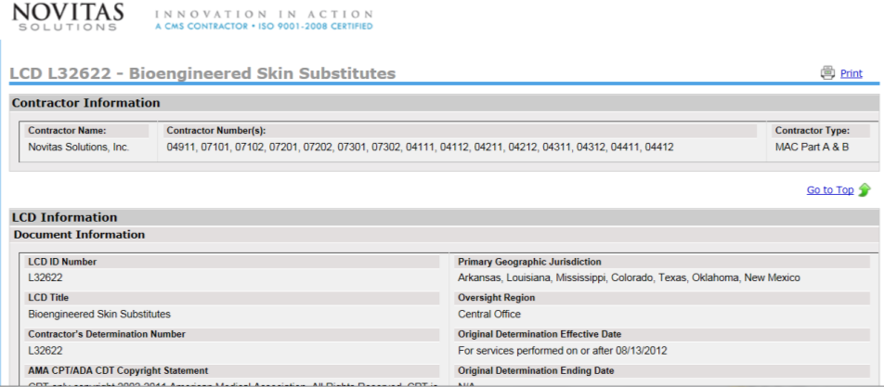
Exclusion criteria in wound healing RCTs have real world implications
Novitas “LCD” for Bioengineered Skin Substitutes
https://www.novitas-solutions.com/policy/jh/l32622-r4.html

Slide 23
Alliance Advocacy of RWE
2005- CMS Medicare Coverage Advisory Committee “Usual Care Of Chronic Wounds”
Efficacy (RCTs) vs Effectiveness (RWE) – RCTs do not reflect typical wound center patients; to assess clinical effectiveness, real world clinical data needs to be used.
2011- Alliance comments to AHRQ “Avoiding Bias in Selecting Studies”
Lack of generalizability to real patients is a form of bias as is the exclusion or underrepresentation of a priority or high risk patient population
2012- Alliance creates: “Consensus Principles for Wound Care Research Obtained using a Delphi Process”
2 principles: address inclusion/exclusion criteria; need for inclusion of vulnerable populations in wound care research

Slide 24
Alliance Advocacy of RWE (cont.)
2012- Meeting with CMS CAG- “Principles for Conducting Wound Care Research”
“Wound care RCTs are not generalizable to our real life patients”
2012- Alliance comments ECRI “Skin substitutes for treating chronic wounds”
2014, 2017- Alliance comments to Novitas on wound care LCD
“Real-world” patients are often not included due to strict exclusion criteria in RCT studies, as are patients with chronic renal disease, morbid obesity and auto-immune disease. These factors can increase the duration and cost of wound care and may impact the effectiveness of advanced therapeutics in ways that cannot be ascertained by RCTs.
2015- Alliance meeting with FDA Inter-Center Wound Healing Working Group –Discuss 2006 Guidance Document

Slide 25
Alliance Advocacy of RWE (cont.)
2016 – Alliance comments to FDA –”Use of RWE to Support Regulatory Decision Making for Medical Devices”
RCTs are not able to evaluate the effectiveness of a wound care product or intervention when more than ½ of patients are excluded from participation, greatly diminishing the applicability of RCT results to real world populations and evidence based medicine
2016 –Alliance letter to FDA General and Plastic Surgery Panel
“Classification of Wound Dressings Combined with Drugs”
Efficacy for antimicrobial dressings in controlled trials or effectiveness in “real world” studies is NOT about wound healing. RCTs do not reflect the real world because the criteria for enrollment, given the endpoints exclude the majority of real world wound care patients.
2019- Alliance comments to AHRQ on Technology Assessment for Cellular and/or Tissue Based Products for Skin Wounds

Slide 26
How RWE Is Viewed By Other Agencies/Organizations
FDA
In 2016, Commissioner Califf articulated the importance of real world data that registries can provide, as well as the need for them in the wound care space.
ECRI
RCT studies, as noted by ECRI, do limit the population that can be included in the studies because of required medical exclusion criteria (i.e. uncontrolled diabetes, poor vascularization, immunosuppressive drugs, end stage renal disease, infection) or required restrictions by FDA labeling.

Slide 27
How RWE Is Viewed By Other Agencies/Organizations
Center for Medicare and Medicaid Services (CMS)
CMS has acknowledged that there is benefit to analysis of “real world” data if information from large numbers of patients can be collected in a uniform fashion (March 29, 2005 Medicare Coverage Advisory Meeting).
AHRQ (at ISPOR meeting)
Difficult to capture real-world complexity in an RCT
Multiple simultaneous variables
Restrictive patient selection criteria
Adherence to protocol in RCT not equivalent to practices in community practice

Slide 28
Next Steps-Issues for Discussion
RWE to be accepted and used both at the FDA and CMS
Evaluate the incremental impact of various exclusion criteria in prospective trials:
Are ALL those exclusion criteria necessary?
- USWR data can tell you which ones really impact outcomes and by how much.
All real patients have more than one wound- can’t you run a trial that way?
Agreed upon standards for RWD so that studies address all the potential sources of bias and how they were handled.
Use of Registries in the creation of RWE data
Development of Quality Measures in Wound Care which will help in Registry data
Alliance Evidence Summit – May 2022

Slide 29
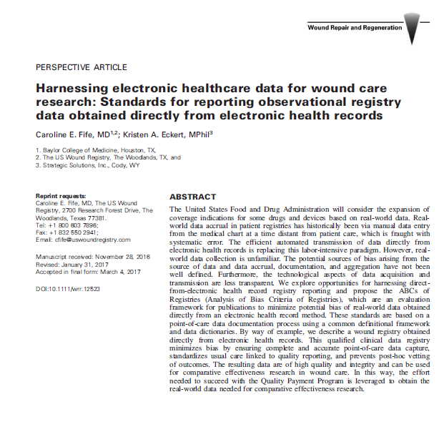
Methods of Controlling Bias in RWD
Quality measures control for variations in the standard of care
A validated risk stratification tool is used to report outcomes in relation to the severity of the wound/patient
Selection bias is controlled by automating the electronic transfer to the entire EHR to the registry
Data entry bias is controlled by linking documentation to billing
Structured data choices for observation manage information bias

Slide 30
Work Group-Gaps
Dr. Li

Slide 31
Suggested Disciplines for New Charter Members
Hospice providers/clinicians
Home health nurses
Occupational therapists
Spinal Cord Injury/Disease specialists
Rehabilitation
Palliative Care
NPUAP (now NPIAP)
NIDDK
CMS
Physical & Rehab medicine
Infectious disease
Prosthetists

Slide 32
Wound Care Collaborative Community
Q&A, May 5 2021

