Slide 1


Member Meeting
June 16, 2021

Slide 2

STEERING COMMITTEE
Oscar Alvarez, PhD | Research
Charles Andersen, MD | Clinician
Ruth Bryant, PhD, RN | Association
Marissa Carter, PhD | Research
Brendan Casey, PhD | Industry
Gary Gibbons, MD | Clinician
Geoffrey Gurtner, MD | Association
William Li, MD | Foundation
Marcia Nusgart, RPh | Association
Bill Padula, PhD | Research
Joseph Rolley, MS | Industry
Randy Schwartz, BA | Strategic Advisor
Tom Serena, MD | Research/Clinician
Rob Snyder, DPM | Academia
Marjana Tomic-Canic, PhD | Research
K. Dev Verma, MD | FDA
WCCC OFFICERS
Vickie R. Driver, DPM, MS, FACFAS | Chair
Lisa Gould, MD, PhD | Vice-Chair
Peggy Dotson, RN, BS | Treasurer/Secretary
Missing Insurance Payor

Slide 3
AGENDA
3:00 pm
Review Meeting Agenda
3:05 pm
Meeting Goals and Objectives
3:10 pm
Challenges in Raising Funding for Wound Care Product Development
Howard Walthall, JD | Founder and CEO, Lumiheal Therapeutics
3:20 pm
Q&A
3:25 pm
Challenges in Conducting Randomized Controlled Trials and
Real-World Hybrid Designs in Wound Care
Marissa Carter, PhD, MA | Owner, Strategic Solutions, Inc.
3:35 pm
Q&A
3:40 pm
Review Work Group Assignments
3:45 pm
Upcoming Meetings
3:50 pm
Q&A

Slide 4

MEETING GOALS AND OBJECTIVES
NEGATIVE PERCEPTIONS ABOUT WOUND CARE
Those who normally invest at this stage of disease and global need are reluctant to invest in wound care related devices/drugs or biologics
Lack of confidence in wound care clinical trial outcomes
510k (or me too) pathway has become the norm
New novel treatments or diagnostics are in severe decline
This funding gap is a significant impediment for clinical medicine and research
Gap identified early as a priority for the WCCC
Notes:
A substantial number of investors who normally invest at this stage of disease and global need often express that they will not invest in wound care-related devices/drugs or biologics because of negative perceptions about wound care. Expressly their lack of confidence in wound care clinical trial outcomes. Therefore, the 510k pathway has become the norm and patients are not getting what they need in new novel treatments or diagnostics. This funding gap is a significant impediment for clinical medicine and research development in our field.
Therefore, we need to focus on this gap as a priority for the WCCC. How we do this and the strategy for success is key. Developing standards, working on the regulatory pathway and publishing the positive potential for researches and industry will be key.

Slide 5
SPECIAL GUEST SPEAKER
Challenges in Raising Funding for Wound Care Product Development
Howard Walthall, JD
Founder and CEO, Lumiheal Therapeutics

Slide 6
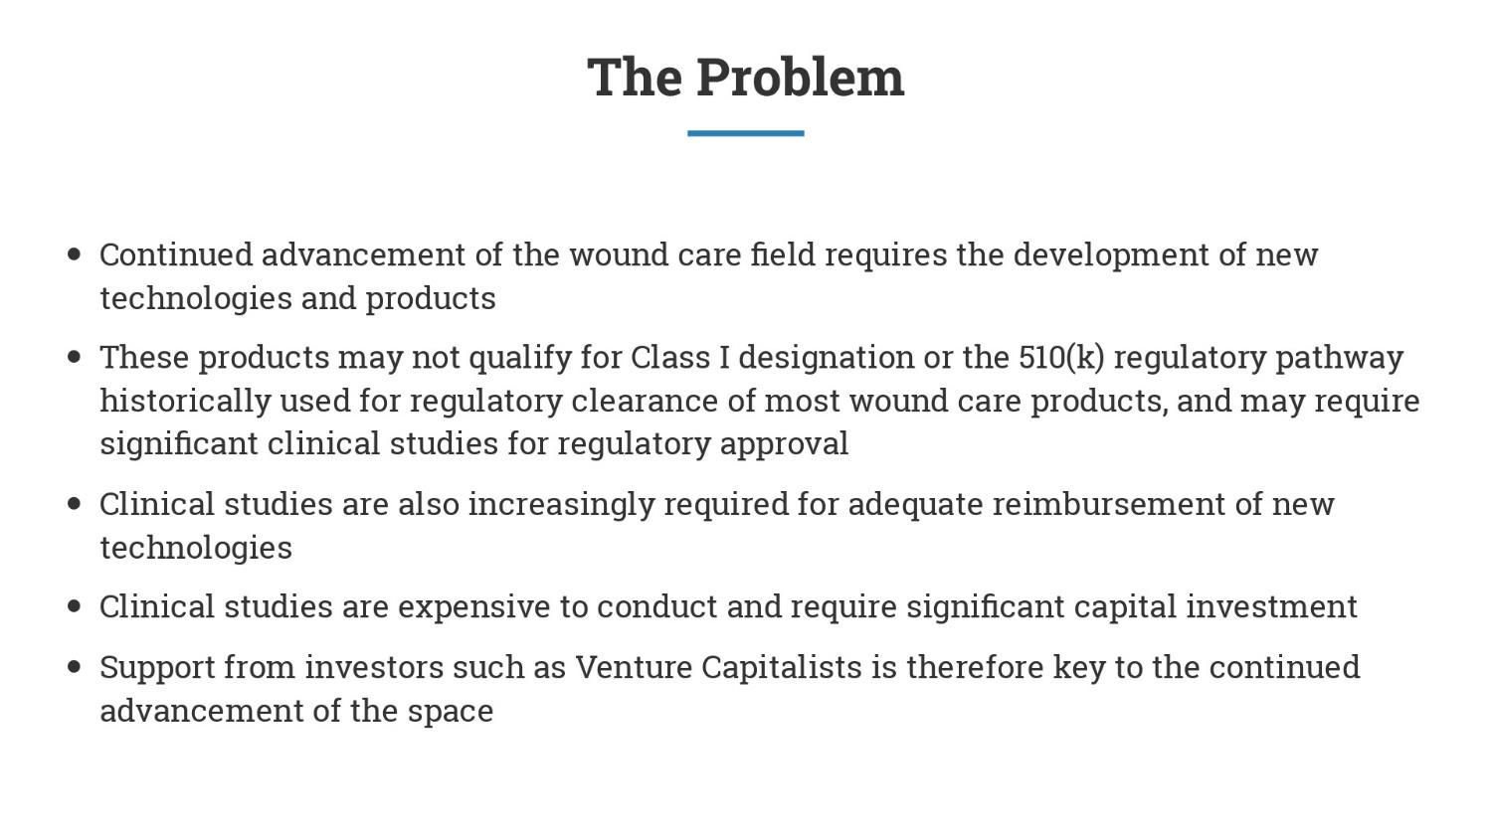

Slide 7
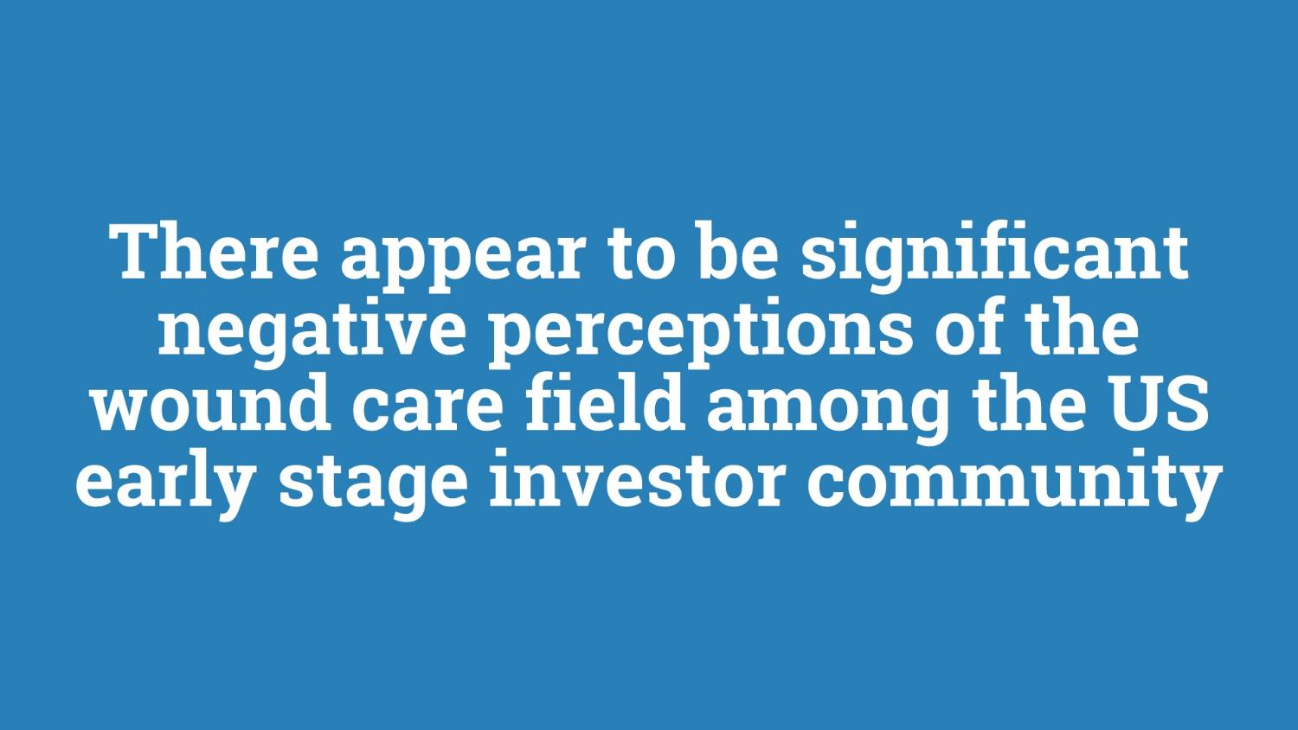

Slide 8
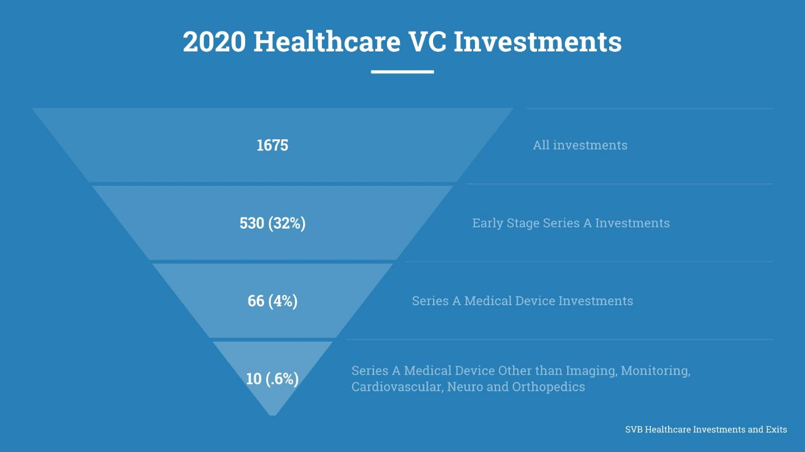

Slide 9
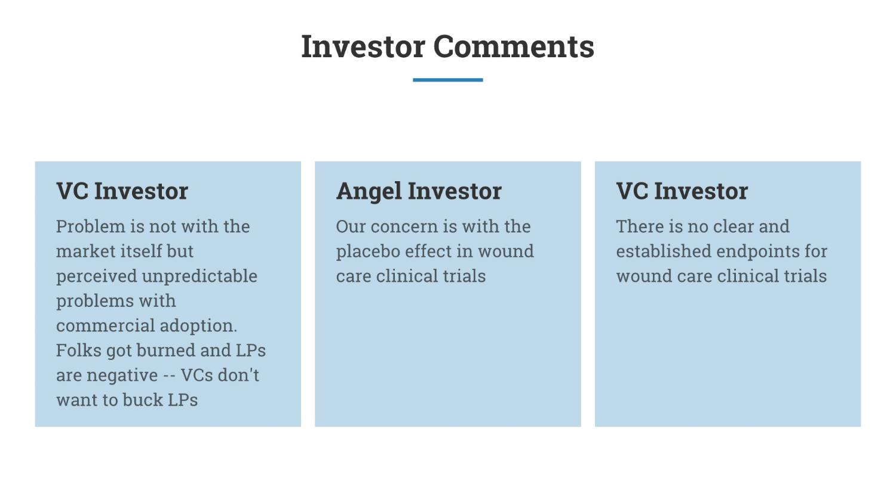

Slide 10
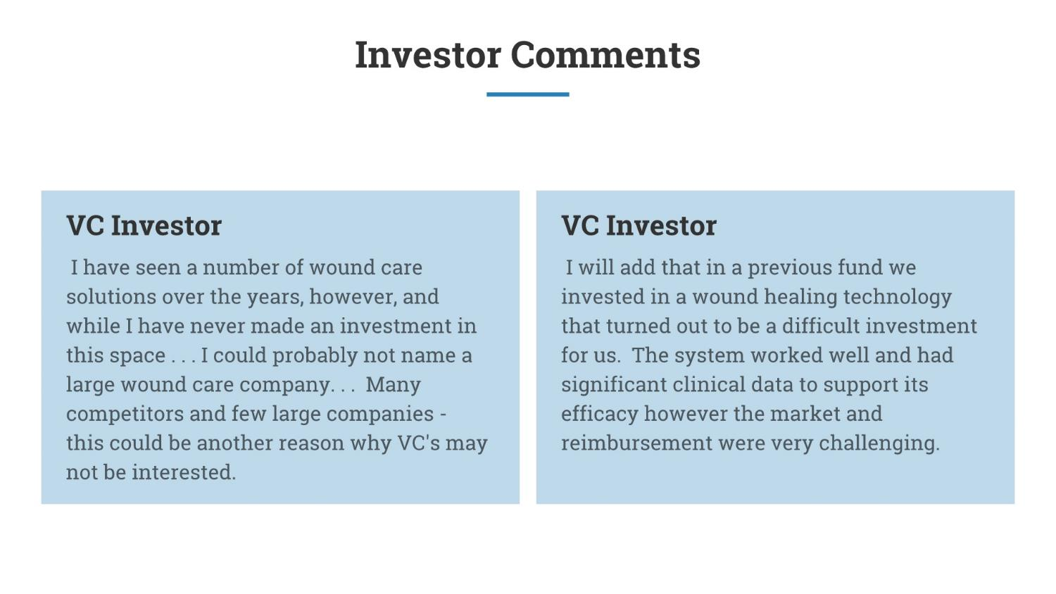

Slide 11
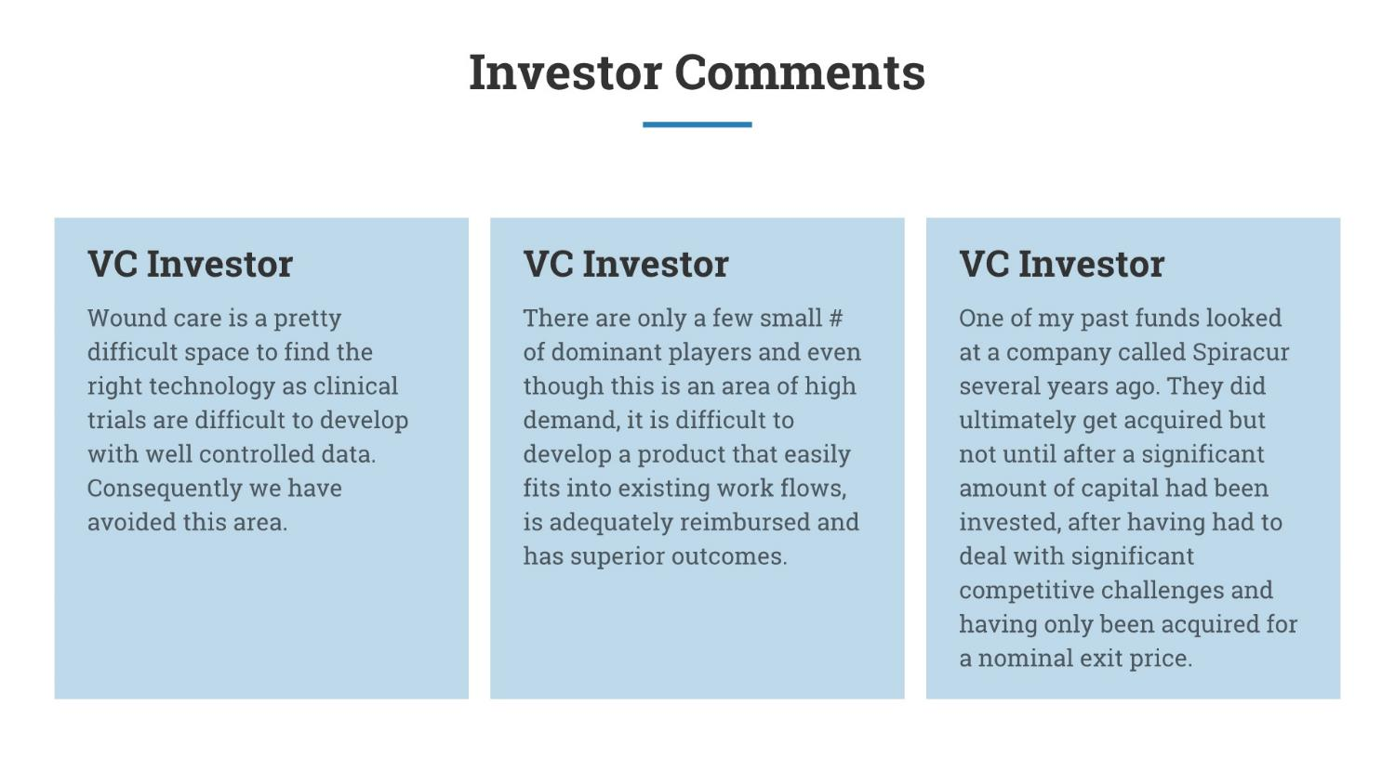

Slide 12
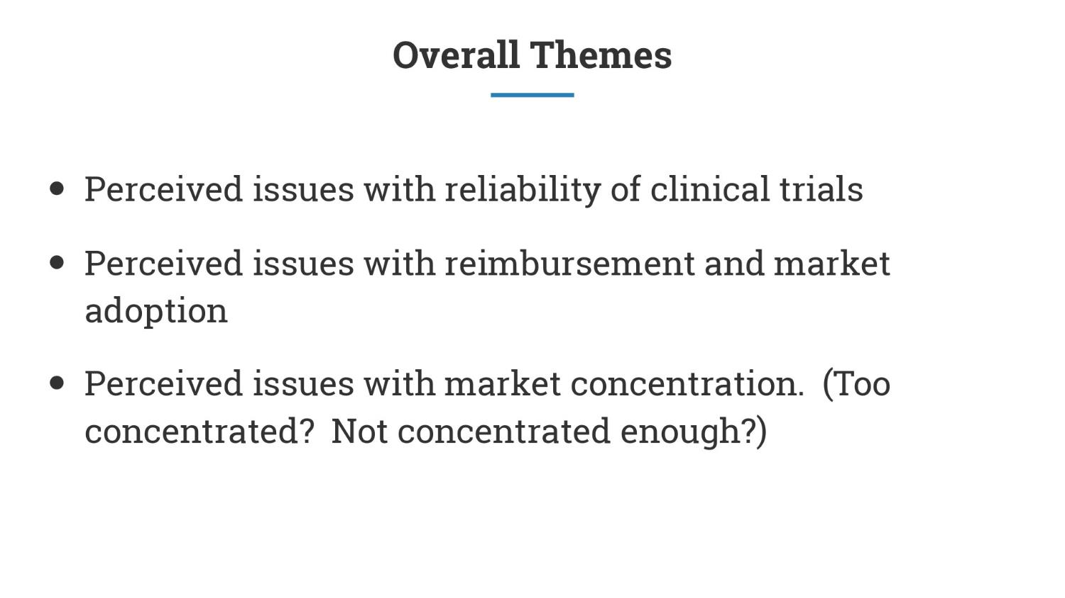

Slide 13
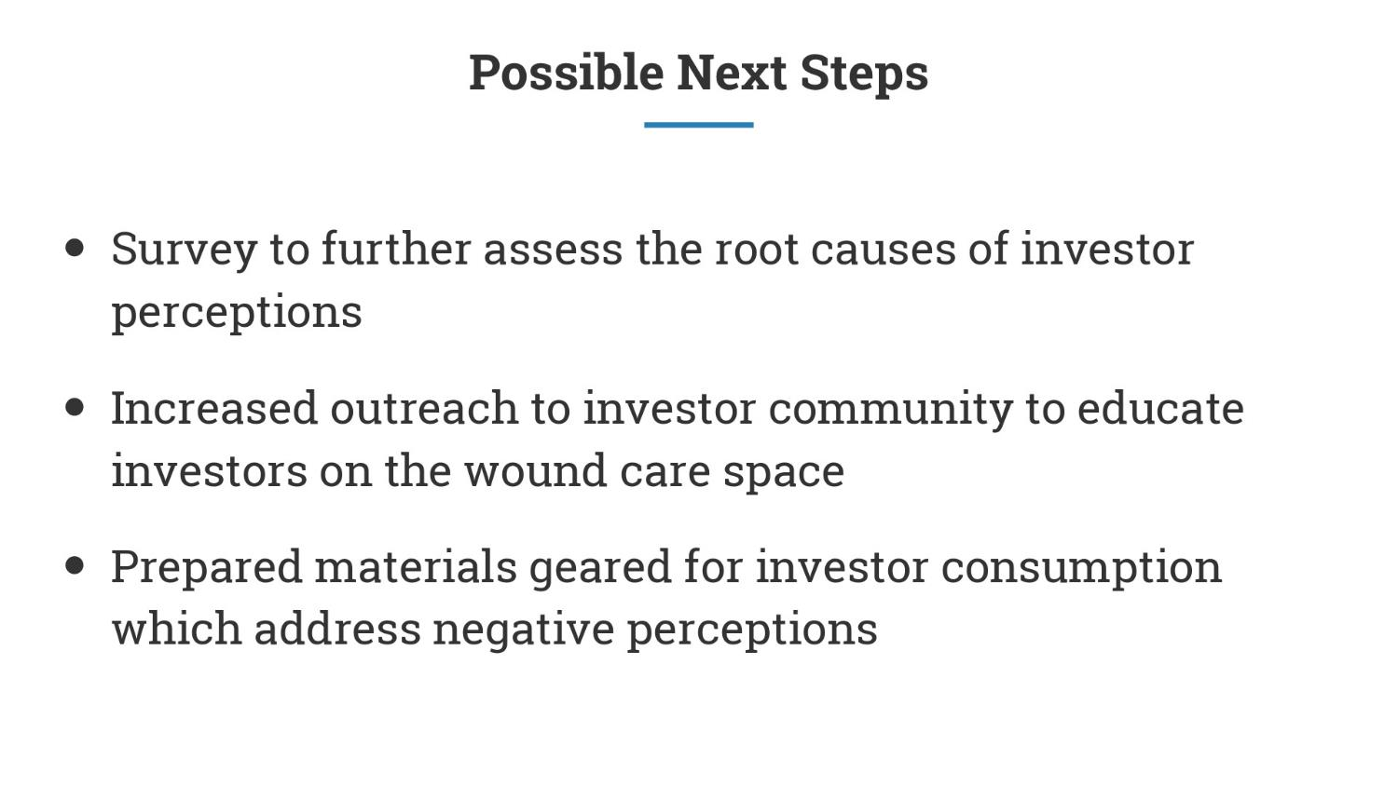

Slide 14

QUESTION/ANSWER AND DISCUSSION

Slide 15
SPECIAL GUEST SPEAKER
Challenges in Conducting Randomized Controlled Trials and Real-World Hybrid Designs in Wound Care
Marissa Carter, PhD, MA
Owner, Strategic Solutions, Inc.

Slide 16

Challenges in Conducting Randomized Controlled Trials and Real-world Hybrid Designs in Wound Care
Marissa J. Carter, PhD, MA, MAPWCA
Bozeman, MT, USA
Strategic Solutions, Inc.

Slide 17
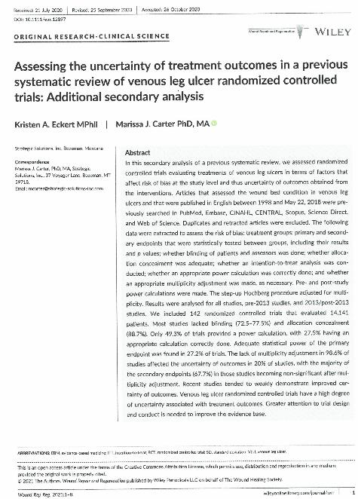
Background
Additional analysis of 142 RCTs involving VLUs based on prior systematic review¹
Systematic review focused on generalizability of RCTs, including socioeconomic status, ethnicity, and recording and reporting of medications and comorbidities.
¹Gethin G, Ivory JD, Connell L, et al.
Wound Repair Regen 2019;27:702-710.

Slide 18
Objectives of Study
Assess other factors that can affect risk of bias and certainty of outcomes (none of these done in Gethin et al study):
Blinding (patient and assessor)
Allocation concealment
ITT (intent-to-treat) analysis
Primary endpoint statistical power (pre and post study)
Attrition rates (overall and by treatment group)
Adjustment for multiplicity of statistical testing (secondary endpoints): percentage of studies affected and percentage of endpoints that became statistically non-significant.

Slide 19
Methods (1)
Check for study duplications and retraction
Classify studies into those published before 2013 or later
Extract study data into Word and Excel files
Blinding, allocation concealment, and ITT analysis conducted in binary fashion (yes/no)
Determine whether pre-study power calculation was done (and done correctly), and calculate power pre- and post-study using available data on primary endpoint(s)

Slide 20
Methods (2)
Calculate attrition rates
Calculate percentage of studies that used appropriate adjustments for multiplicity of statistical testing of secondary endpoints
Carry out adjustment for multiple secondary endpoints using step-up Hochberg procedure:
Use reported p values
Impute p values conservatively if necessary as follows: non-significant: p=0.06; p<0.05: p=0.04; P<0.01: p=0.009, etc.

Slide 21
Overall Results
Two studies excluded (one was a duplication and one had been retracted)
14,141 subjects in 142 studies
68.3% published before 2013 and 31.7% during or after 2013

Slide 22
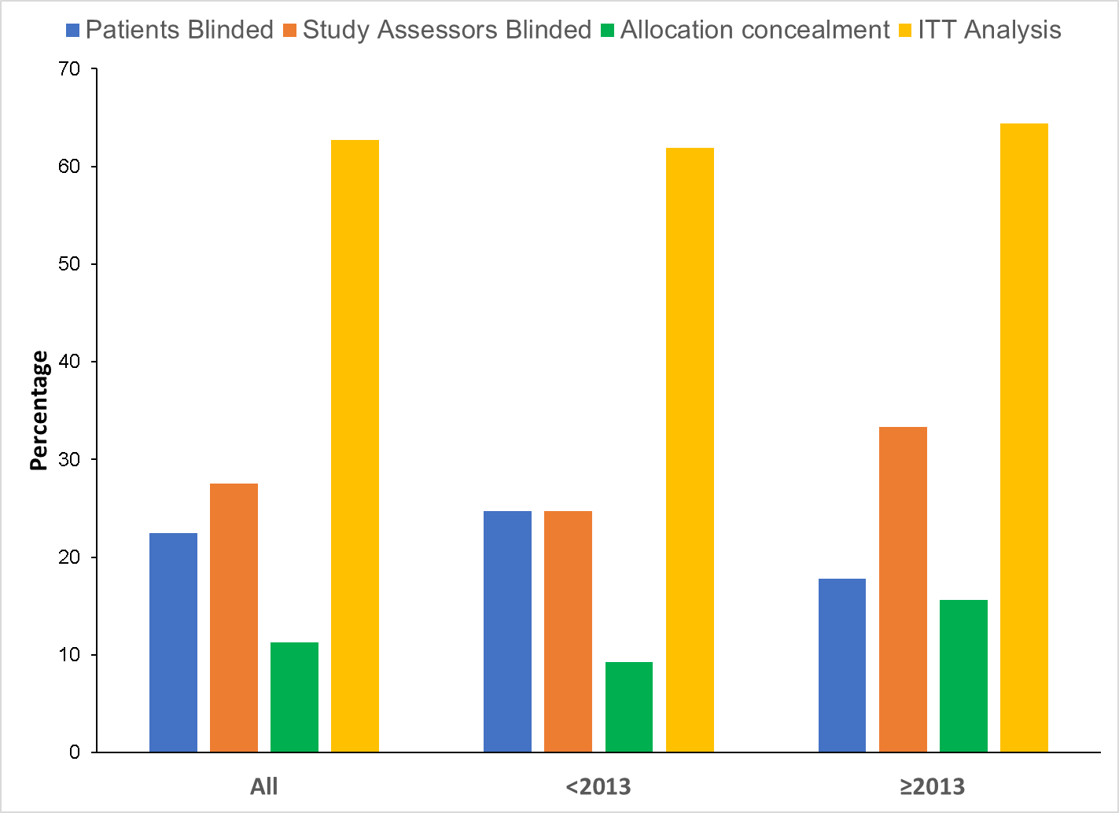
Blinding, Allocation Concealment and ITT Analysis

Slide 23
Power Calculations (1)
Only half of all studies reported any power calculation
Only 27.5% reported the power calculation data and did it correctly (28.9% prior to 2013 versus 24.4% later)
34% reported an initial power calculation for the primary endpoint
Only 27.2% of studies had an adequate post-trial power for the primary endpoint(s)

Slide 24
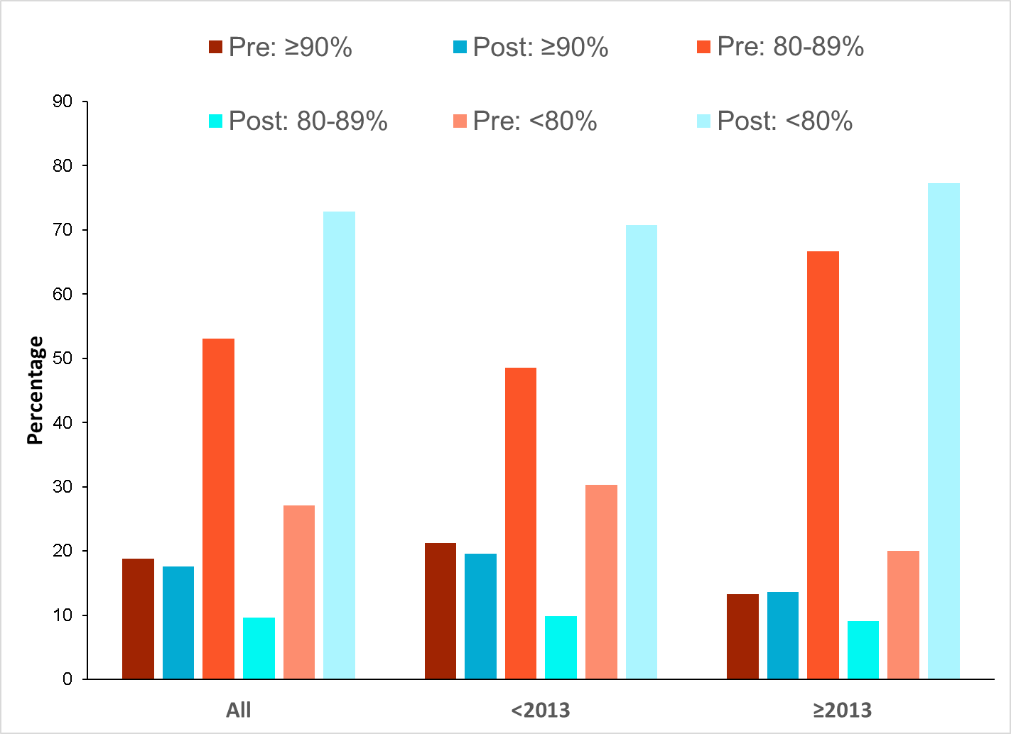
Power Calculations (2)

Slide 25
Multiplicity of Statistical Testing
Only 2 studies (1.4%) had appropriate adjustment (both ≥2013)
19.5% of studies were negatively affected when appropriate adjustment was undertaken
For these studies two thirds of the endpoints became statistically non-significant
Whereas the percentage of studies affected changed little with respect to time, 71.0% of these endpoints became non-significant prior to 2013 versus 59.5% afterward.

Slide 26
Attrition Rates
For all studies the attrition rate was 12.4% prior to 2013 and 7.6% afterward
29 studies (20.4%) had overall attrition rates of 20% of greater (25.8% prior to 2013 and 8.9% afterward)
8 studies (5.6%) had greater than 20% difference between treatment groups (equally divided between time periods).

Slide 27
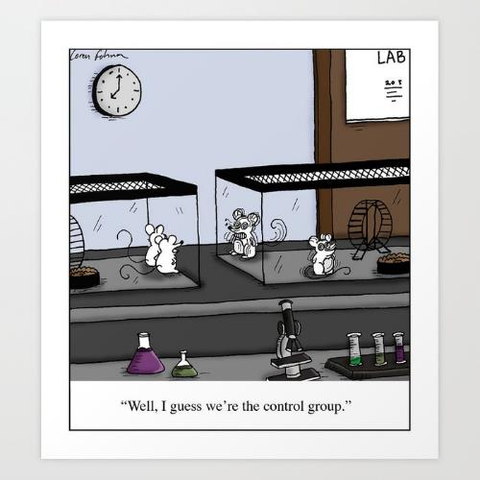
Final Thoughts on RCTs
Patient blinding is poor and getting worse, perhaps due to the new cellular and/or tissue-based products; but assessor blinding is getting better
Allocation concealment is still not being properly reported
ITT analysis is not as high as it should be
Power calculations are far too optimistic when they are done, often done incorrectly or poorly reported, and post-trial power is very frequently inadequate
Corrections for multiplicity of statistical testing are rare and a fifth of all trials would be badly affected it was done properly.

Slide 28
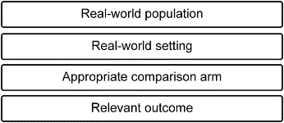
Background to “real-world” Hybrid Trial Design (I)
Evolved out of classic case-control design and cohort-matching work
The “cases” are now a prospective intervention group
The “control” group is now a cohort receiving ordinary standard of care but the group is not prospectively followed in the traditional sense
Instead we collect data on patients and outcomes from Electronic Healthcare Systems (EHRs).

Slide 29

Background to “real-world”Hybrid Trial Design (II)
Benefits:
Generalizability should be better
Outcomes should be more realistic
In theory, can be conducted more quickly
Should cost less
How to operationalize?

Slide 30
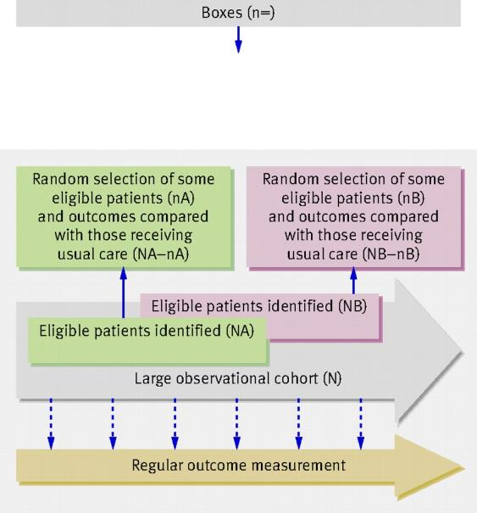
Hybrid Trial Design (I)
Large observational cohort of patients with problem is recruited (N); outcomes regularly measured.
For each RCT, information from the cohort is used to identify all eligible patients (NA).
Some eligible patients (nA) are randomly selected and offered intervention.
Outcomes of randomly selected patients (nA) are compared with outcomes of eligible patients not randomly selected—those receiving SOC (NA − nA).
Process can be repeated for further RCTs (for example, NB)
Relton C, et al. BMJ 2010;340:c1066.

Slide 31

What’s Needed?
EHR system that has integrated wound care component
One-group trial protocol (the intervention) with 1 or more sites that are part of the EHR system
Ability to select control arm candidates based on inclusion and exclusion criteria prospectively or retrospectively.

Slide 32
What Are the Problems? (I)
Inclusion and exclusion criteria:
Some I&E criteria cannot be applied because test values are not available (e.g., with past 3-6 months)
Some exclusion criteria cannot be easily searched for in medical records
Large selection biases
Standard of care:
Many patients get advanced wound care; some get prohibited therapies or “gray area” therapies
Standard of care itself may be poorly documented
Standard of care may be subpar or quite different than specified in the intervention group for a variety of reasons

Slide 33
What Are the Problems? (II)
Right-censored outcomes
Loss to follow-up is much higher than for controlled trials
Hard to track patients outside of wound care outpatient departments or podiatrist offices
No data from other settings
No consistent definition of when a wound is healed
If a patient visits another setting some states/EHRs require the wound to be identified as a “new” wound to the system when returning to the wound care facility
Visit frequency
Patients often seen less frequently than in controlled trials and are sometimes seen “virtually”

Slide 34
What Are the Problems? (III)
Measuring equipment
Sometimes less sophisticated than that used in controlled trials (e.g., camera system vs ruler)
Treatment patterns
May be quite different to those specified in the controlled intervention group
Patient numbers
Need large control patient numbers because of I&E issues
May need larger intervention group (vis-à-vis RCT) because of statistical power issues
Outcomes may be more uncertain than RCTs

Slide 35
Summing Up
Real-world hybrid trials can end up being more complicated to run than conventional RCTs
If we have to consent control group patients in order to run tests on screening this defeats the object of a hybrid trial
Results of such trials may be subject to much more uncertainty compared to RCTs
It may be better to conduct RCTs that are more pragmatic with looser controls
We don’t know whether hybrid trial will constitute traditional level 2 evidence
We don’t know how agencies or payers will judge the level of evidence of such trials.

Slide 36
QUESTION/ANSWER AND DISCUSSION

Slide 37

WCCC WORK GROUPS
Co-Chairs
Initial goals and objectives
Process forthcoming

Slide 38
REVIEW WORK GROUP ASSIGNMENTS:
WORK GROUP CO-CHAIRS
Tools/Methods
TBD
Clinical
Oscar Alvarez, PhD
Research
Tod Brindle, PhD
Industry
K. Dev Verma, MD
FDA
Real World Data
John Lantis, MD
Clinical
Marissa Carter, PhD
Research
Joseph Rolley, MS
Industry
K. Dev Verma, MD
FDA
Gaps
Tom Serena, MD
Clinical/Research
William Li, MD
Clinical/Research
Randy Schwartz, BA
Industry
K. Dev Verma, MD
FDA

Slide 39

UPCOMING MEETINGS
Steering Committee
July 12, 5:00pm EDT
Member Meeting
Late August, TBD
Work Groups – Start in July based on Chairs’ discretion

Slide 40





QUESTION/ANSWER
DISCUSSION
P: 312.201.6771
F: 872-282-1010
139B James Comeaux Rd, Ste 555
Lafayette, LA 70508
info@woundcarecc.org
www.woundcarecc.org

