Slide 1
Member Meeting January 10, 2023 5:00 PM ET

Slide 2
Welcome and Agenda
Welcome Dr. Driver
Guest Speaker Introduction J. Rolley
Real World Data Landscape Overview T. Scarnecchia
Q&A/Discussion Dr. Driver/T. Scarnecchia
Work Group Updates H. Walthall/Dr. Alvarez/J. Rolley
Other Business Dr. Driver
Adjourn

Slide 3
Work Group Updates
Gaps H. Walthall
Tools Dr. Alvarez
Real World Evidence J. Rolley

Slide 4
Other Business/Discussion
Reminder, 2023 Member Meeting Schedule
April 18, 2023
July 25, 2023
October 24, 2023

Slide 5
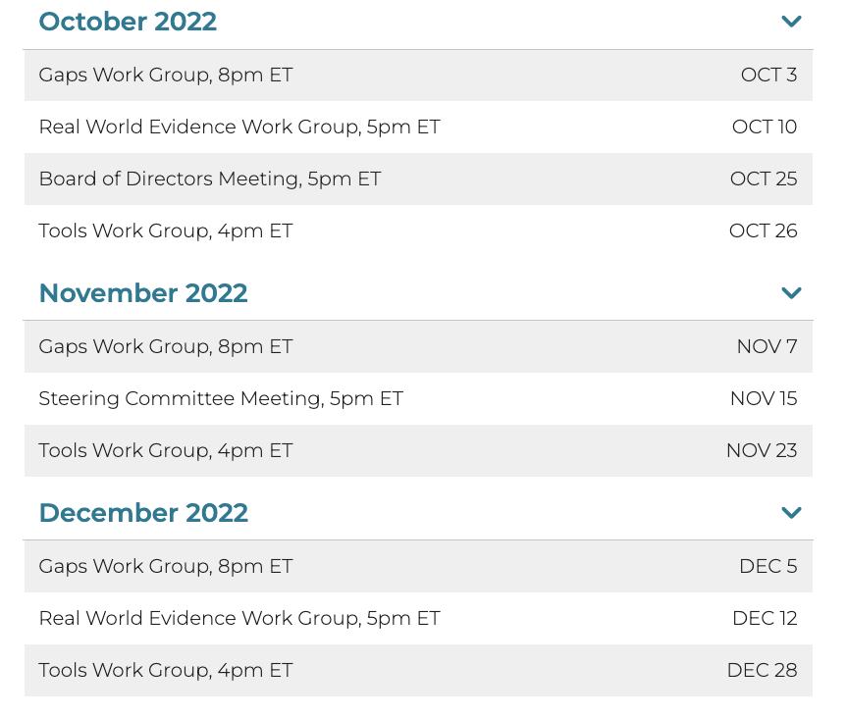
Meetings - Admin Overview
All WCCC internal meetings are located at www.woundcarecc.org/meetings
Member login required to view Zoom login link and call-in numbers

Slide 6
Meetings - Admin Overview
Reminders are sent based on member profiles and assigned work groups
Members can add to calendar direct from email reminders

Slide 7
NEXT MEETING
Tuesday, April 18, 2022
5:00 pm ET/4:00 pm CT/3:00 pm MT/ 2:00 pm PT

